Slide 1
Mobile-App Privacy
Nutrition Labels Missing
Key Ingredients for Success
Presentation by:
Shirshak Bajgain

Slide 2
What is privacy?
Privacy is the ability of an individual or group to seclude themselves or information about themselves, and thereby express themselves selectively.

Slide 3

Why privacy is relevant to us?
Technology - Social Media, Apps etc.
Government - Recent case Roe V Wade
Police
Physical Safety

Slide 4
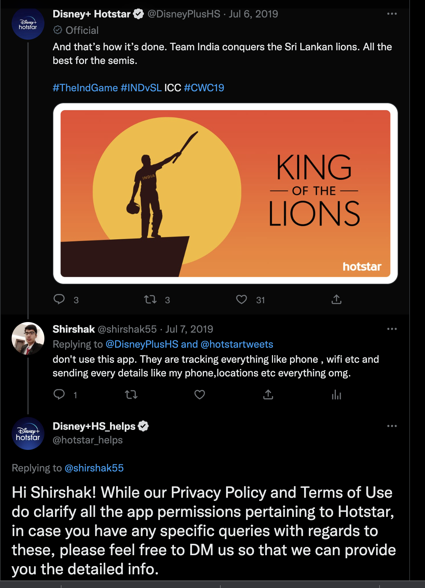
Privacy issue I have faced
How did I know disney hotstar was sending every details?
MITM (Man in the middle attack). These apps make it hard to MITM via certs pinning.
Dynamic Instrumentation via Frida
Reverse Engineering

Slide 5
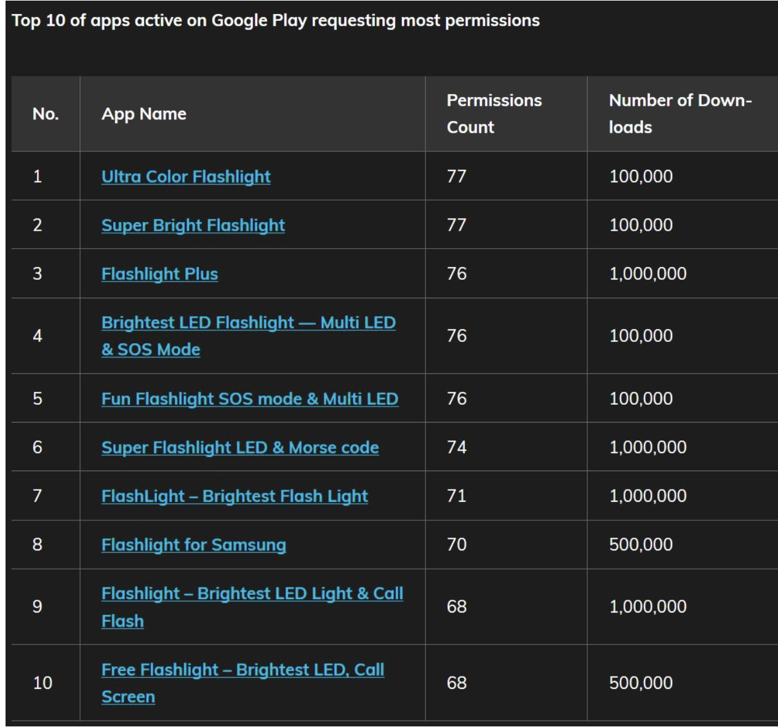
Privacy issue I have faced
Why would torch app require access to wifi?

Slide 6
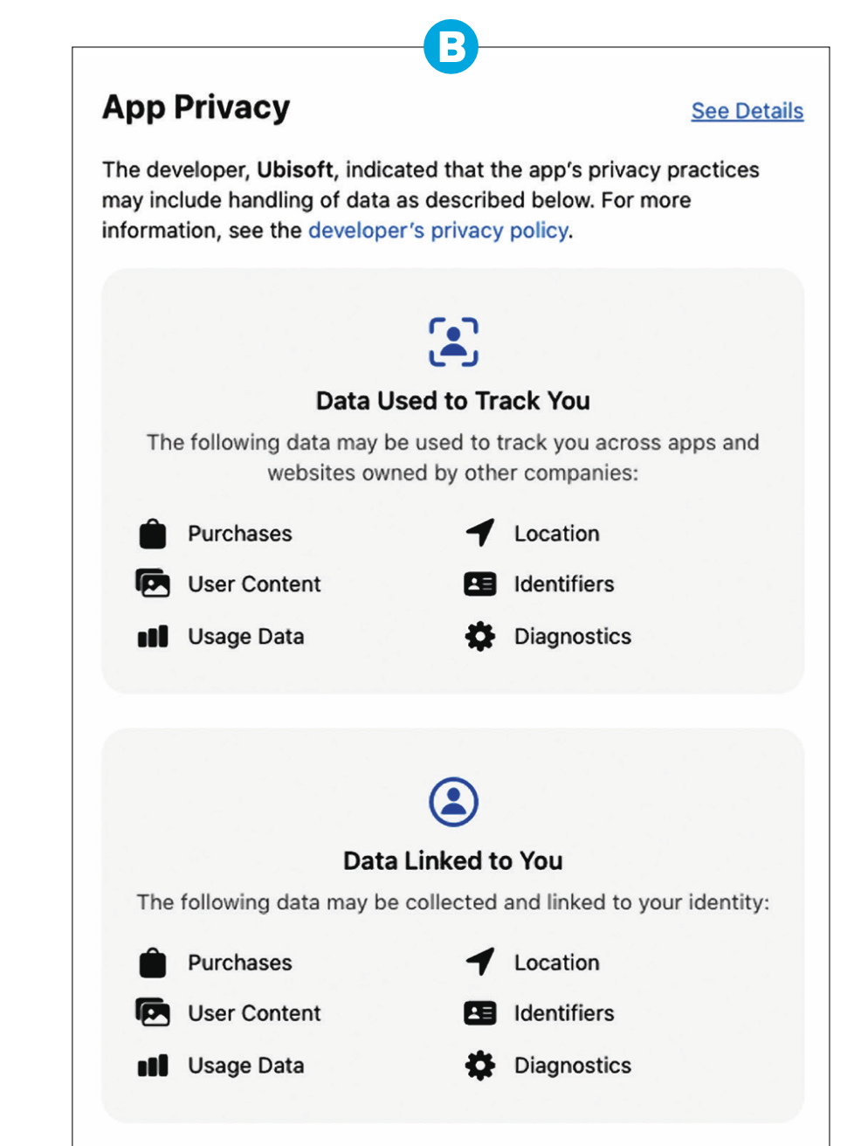
Actions from Appstore?
Privacy Nutrition Label

Slide 7
Problem with appstore privacy labels:
Labels not prominently placed.
Confusing terminology
In Feb 2021, Members of congress wrote to Apple CEO Tim Cook with concerns that app labels were misleading consumers.
Apple documentation is ambiguous and computer scientists generally don’t prefer ambiguous stuff.

Slide 8
The Idea behind privacy nutrition label
Privacy policy is hard to read. Almost nobody read it. They are like terms and condition where people accepts it without reading and understanding.
Food nutrition labels make easier for people who are interested in seeking healthier food choice. Similarly, privacy label empowers people to avoid apps and websites that breaches privacy.
Offers an opportunity to present privacy information in simple, standardized language for easy comparison.

Slide 9
The Idea behind privacy nutrition label
Privacy policy is hard to read. Almost nobody read it. They are like terms and condition where people accepts it without reading and understanding.
Food nutrition labels make easier for people who are interested in seeking healthier food choice. Similarly, privacy label empowers people to avoid apps and websites that breaches privacy.
Offers an opportunity to present privacy information in simple, standardized language for easy comparison.

Slide 10
Why is privacy label hard?
Reliance on third party library.
Developer use various external libraries and they themselves aren’t generally aware regarding the data collected by these libraries. Example include facebook SDK used to show facebook login button.
Confusing terminology
Many terms like “data not linked to you” have different meaning. There are various data elements that are not inherently identifiable nonetheless can be linked to individual because they are stored with identifiable data.

Slide 11
A Recipe for Success
Developer tools can assist developer to label privacy.
App store should use automatic verification techniques to verify accuracy of privacy labels.
Make labels easier to understand. For example including the important information at the beginning.
Privacy labels should be placed prominently in appstore where they are visible without scrolling.

Slide 12
Thank You

